Slide 1
Dynamics of Social Networks
MSc Thesis Presentation
10 September 2019
Author: John Freeman
Supervisor: Alex Carver

Slide 2
Objectives
Dynamic Social Network Model
Needs to approximate real world networks
Needs to be dynamic and growing
Needs to be efficient enough to generate many examples quickly
Node Embedding System
Needs to generate good embeddings
Embeddings must be stable in time

Slide 3
General Background
Social networks
Diffusion
Organization
Growth
Machine learning
Neural networks
Node embeddings

Slide 4
Modelling Real Networks
Create random networks that approximate their real-world counterparts
Allows us to easily generate a lot of training data
And learn things about networks along the way
Can be verified using numerous properties of real-world networks
Scale-freeness, small-worlds, self-similarity…
Many more we don’t go into

Slide 5
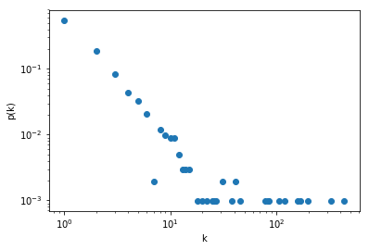
Scale-Free Networks
Networks whose degree distribution follows a power law
Emergent property of numerous real networks
Such networks characterized by presence of “hubs”
Many nodes with few connections, few nodes with many connections
Degree distribution of a scale-free network

Slide 6
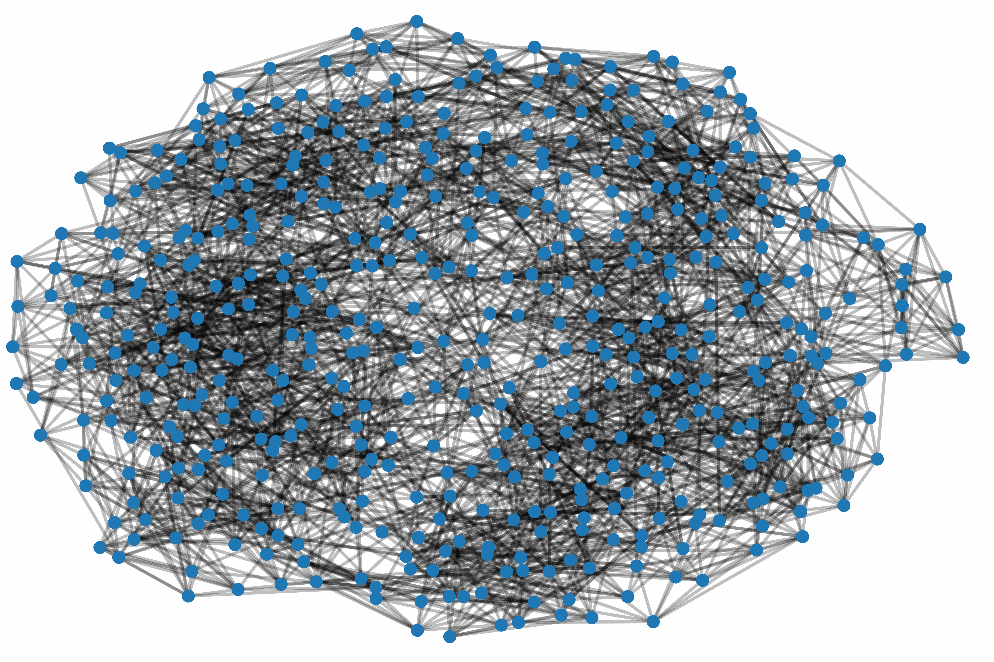
Small-World Networks
Networks with “6 degrees of separation”
Low average shortest paths
High average clustering
Broadly defined
Common in the real world
A random small-world network

Slide 7
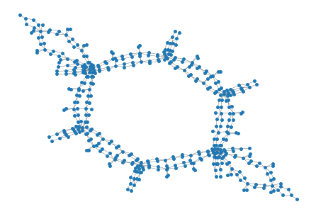
Self-Similar Networks
Network equivalent of a geometric fractal
Highly modular
Properties of network invariant to “renormalizations”
Measured through generalized box-covering
A random self-similar network

Slide 8
The Apt-Markakis Product Adoption Model
Simulates diffusion of competing products across a network
Some nodes are initialized to have adopted a product
Iteratively checks which nodes without products can adopt one based on a preset threshold
Numerous possibilities for generalization
Multi-product vectors
Continuous valued products

Slide 9
The Schelling Segregation Model
Designed to simulate racial segregation in neighborhoods on a 2d grid
Agents belong to one of several disparate groups
A predefined threshold defines how many agents of a different group a node will tolerate being adjacent to
Agents move to free spaces on the grid when threshold exceeded
Generalization to graphs is non-trivial due to lack of empty spaces
Agents can swap location in the graph if both unhappy
Agents can create/break links at will if unhappy

Slide 10
The Barabási-Albert Scale-Free Model
Creates random scale-free networks based on preferential attachment
Starts with a random connected graph
Iteratively adds nodes
A new node u connects to an existing node v with probability deg(v)/2|E|
Creates a “rich get richer” behavior, where high degree nodes see their degrees increase faster than those with low degree

Slide 11
Machine Learning on Graphs
Relatively new application area of machine learning
At least relatively new successful area
Many techniques and problems exist
Spectral methods, language models, neural networks
Clustering, link prediction, classification, etc.
Latest and most successful techniques based off neural techniques

Slide 12
Autoencoders
Type of unsupervised network composed of an encoder and a decoder
Goal is to find an embedding of the input in a much lower dimensional space
Achieves this through optimizing reconstruction error
Encoder learns a transformation from input to embedding space
Decoder learns a transformation from embedding to input space
Optimize both in tandem to minimize difference between encoder input and decoder output

Slide 13
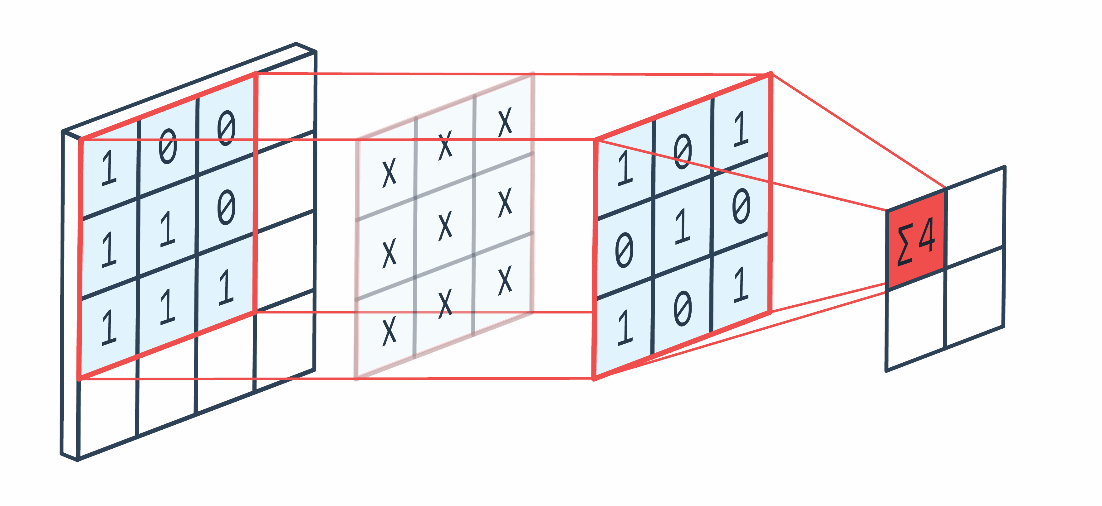
Convolutions
One of the most important operations in neural networks
Allows neighborhood information to be considered
Learns a filter over a pixel and some radius of its neighborhood
2d Convolution visualization
Source: Peltarion

Slide 14
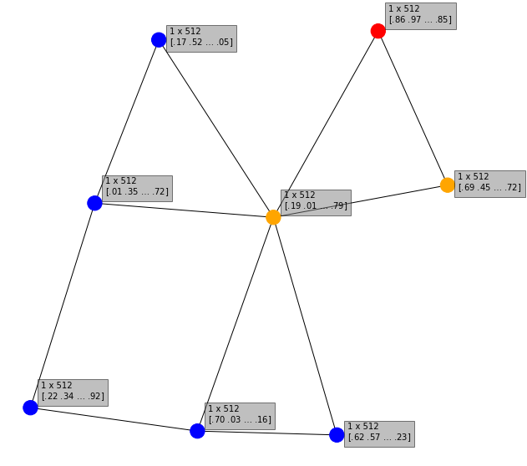
Graph Convolutions
Generalizing convolution to graphs is non-trivial
In images, pixels have regular structure
In graphs, nodes can have any amount of neighbors
Solution: fancy complicated math
Graph convolution, radius 1, target in red

Slide 15
Chebyshev Convolutions
Method proposed by Defferard et al
Fast and local
Localization achieved through use of the fourier space
Expensive to compute – O(n^2)
Speed achieved by use of Chebyshev polynomials – O(k), where k is radius
Other filtering techniques exist, most perform worse or have no standard implementations

Slide 16
Node Embeddings
Want to capture as much information about a graph as possible in a vector space
Should be able to use embeddings to get similar results to the true graph in similar problems
Clustering vs partitioning
Several goals to optimize
Standard reconstruction error
Maximize distance between non-neighboring nodes

Slide 17
Dynamic Node Embeddings
Instead of a single graph, have a series of graphs that change over time
Similar problem domain to static embeddings, but need stability
Retraining from scratch each times could result in very different embeddings
Euclidean space is infinite, many good embeddings exist
Need stability between successive graphs, at least proportional to changes
Initialize embeddings at step t to those of t-1 via net2net
Stability can be measured through Frobenius norm of difference between successive embeddings

Slide 18
Implementation and Results
Built a network model composed of Apt-Markakis, Schelling, and Barabási-Albert models, with minor modifications
Exhibits numerous emergent behaviors, similar to real-world networks
Built a random-walk augmented autoencoder using graph convolutions to do efficient dynamic node embeddings
Outperforms existing methods in most cases

Slide 19
Synthetic Model Design I
Inspired by a previous project combining Apt-Markakis and Schelling
Node embedding is well-studied on static graphs, and even on graphs with a constant number of nodes
Needed to make networks dynamic and growing
Barabasi-Albert model handles the latter, Schelling the former
Used continuous valued products for the Apt-Markakis component
Allows a greater range of emergent communities to form

Slide 20
Synthetic Model Design II
Initialized to a small random connected graph
Iterates over the three models: BA, Apt-Markakis, then Schelling
250 iterations of the synthetic model, colored by Apt-Markakis product

Slide 21
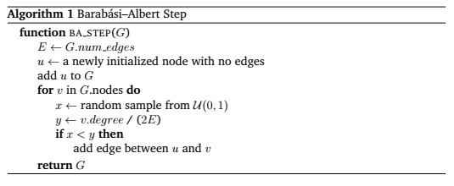
Barabasi-Albert Component
Effectively the same as the original model
New node initialized to have or not have a product
Preferentially attaches to existing nodes based on degree
BA step pseudocode

Slide 22
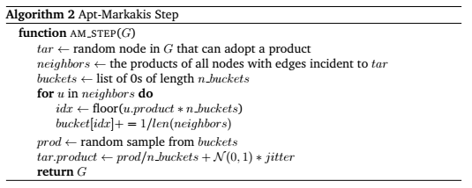
Apt-Markakis Component
Selects a random node that can adopt a product
Creates a distribution over its neighbors
Samples from that distribution for the new product
Adds in random noise to encourage differences
AM step pseudocode

Slide 23
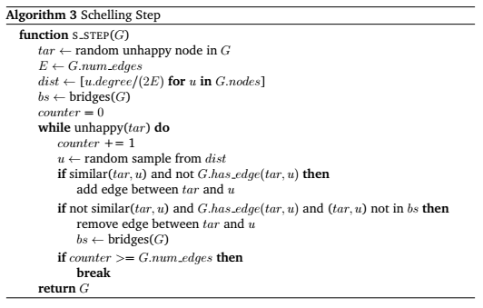
Schelling Component
Selects a random unhappy node
Creates a distribution over all nodes based on degree
Samples from that distribution for node to check
Adds or breaks link based on difference in product
Avoids breaking bridges
Schelling step pseudocode

Slide 24
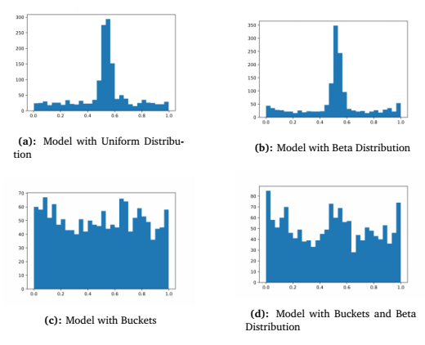
Edge Saturation Issue
Continuous products tended to cluster towards average
Resulting networks had only one community
Several solutions attempted
U-shaped Beta distribution
Bucket sampling
Still not ideal
Final product distribution historgrams

Slide 25
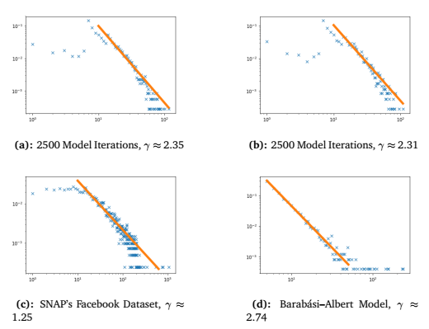
Model Scale-Free Analysis
Model was not perfectly scale-free
Exhibited scale-freeness in upper tail
Behavior mirrored by real-world datasets
Model encourages edge formation, contributing to fewer low-degree nodes
Degree distributions of models

Slide 26
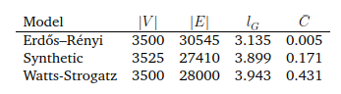
Model Small-World Analysis
Model exhibited moderate small-world characteristics
Higher average clustering than random graphs
Shorter average shortest path length than random graphs
Average shortest path length and average clustering coeffient

Slide 27
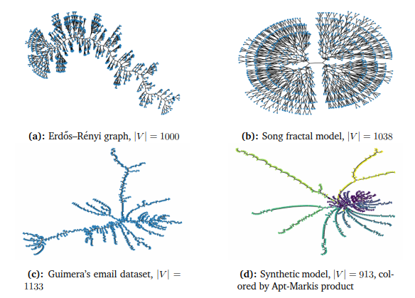
Model Self-Similarity Analysis – Girvan Newman I
Self-similarity measured through analysis of GN algorithm clusters
Dendrogram structure and cumulative distribution appears self-similar
Bifurcation ratios less so
Inconclusive
GN Algorithm dendrograms, in synthetic case colored by Apt-Markakis product

Slide 28
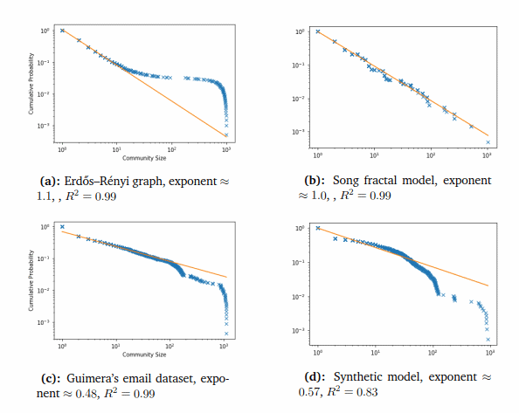
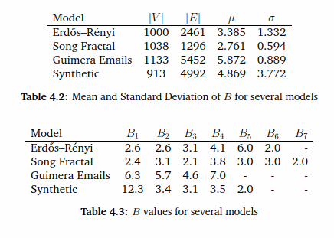
Model Self-Similarity Analysis – Girvan Newman II
Cumulative community distributions
Bifurcation ratios and statistics

Slide 29
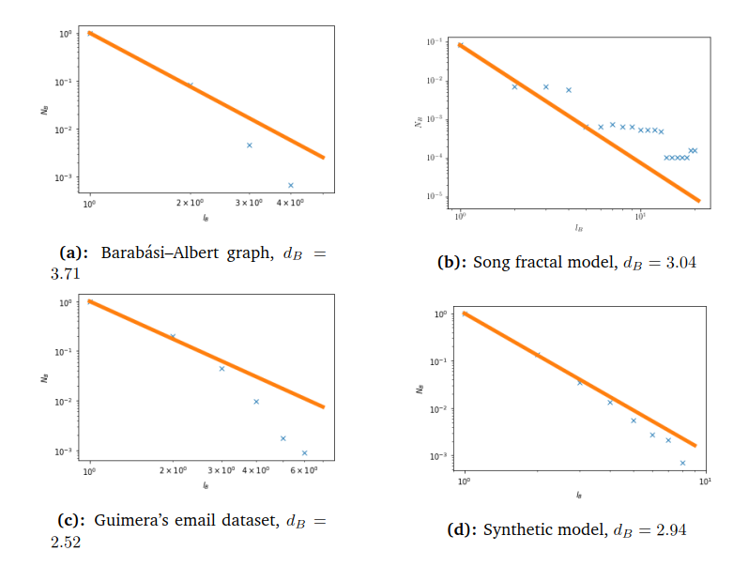
Model Self-Similarity Analysis – Box Counting
Self-similarity measured through box counting
Sample nodes at random, setting their neighborhood of radius r to be covered
Continue until whole graph covered
Fit power law to resulting curve
Analysis again inconclusive
GN Algorithm dendrograms, in synthetic case colored by Apt-Markakis product

Slide 30
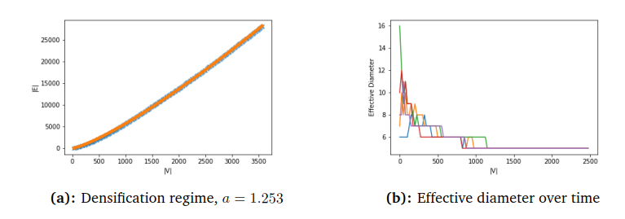
Bonus Analysis: Densification
Unexpected result
Plot of nodes against edges follows power law
Effective diameter slowly decreases to stabilize around 3-4
Thought to be common in real networks
Result of Schelling step
Average shortest path length and average clustering coeffient

Slide 31
Embedding System Objectives
Results needed to be usable to solve problems
Results needed to be stable over time
System needed to be somewhat fast
Needs to work on growing graphs

Slide 32
Embedding System Design
Random walk augmented graph convolutional autoencoder
RWGCN, or just the embedding system
Autoencoder working on adjacency matrix
Augment adjacency matrix with truncated random walks
Graph convolutional architecture
net2net to grow input/output layers on network expansion
Problem-specific choice of Adam or SGD with momentum

Slide 33
Random Walk Augmentation
Graph convolutions can capture a lot of neighborhood information
Random walks can capture more, and help introduce randomness to make the training process robust
At each training iteration, run a random walk at each node with reset probability 0.1, of length |V| * sparsity
Augment adjacency matrix by setting all nodes in walk to be neighbors, train as normal

Slide 34
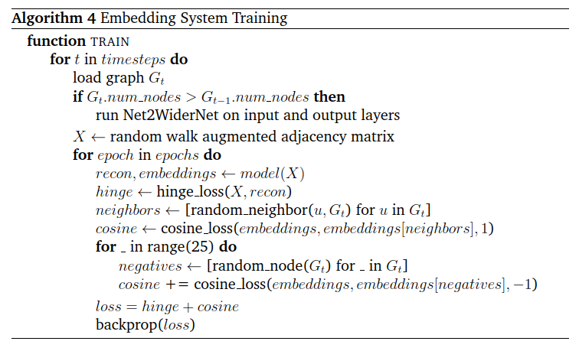
Loss Functions and Training Procedure
Cosine loss
Push adjacent node embeddings closer together
Push non-adjacents farther apart
Hinge loss
Reconstruction error as a multi-label classification problem
Embedding system training pseudocode

Slide 35
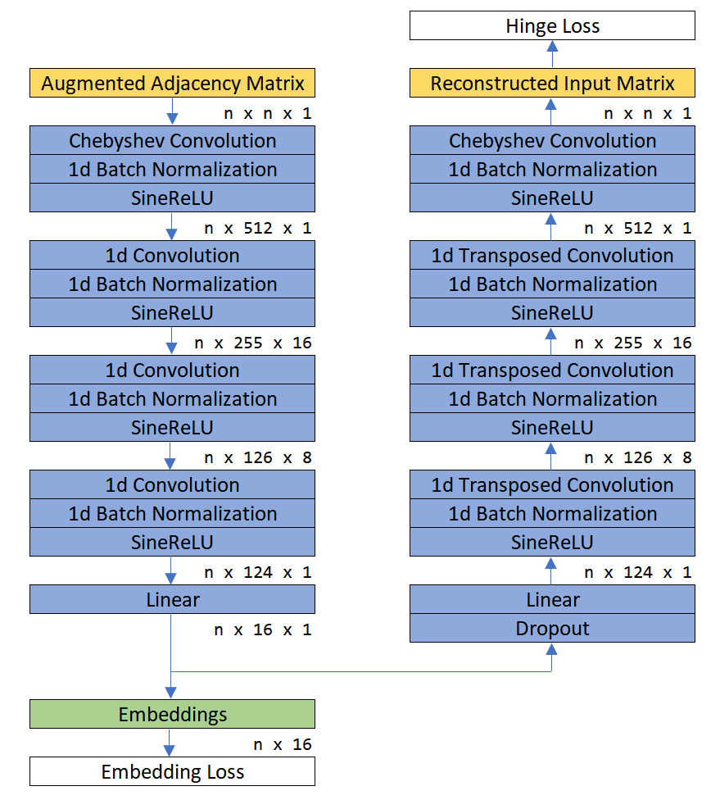
Embedding Network Architecture
Chebyshev convolutions on input/output layers
Middle layers of 1d convolutions
Embedding linear layer
Batch normalization and SineReLU
Dropout layer between encoder and decoder
Embedding system network diagram

Slide 36
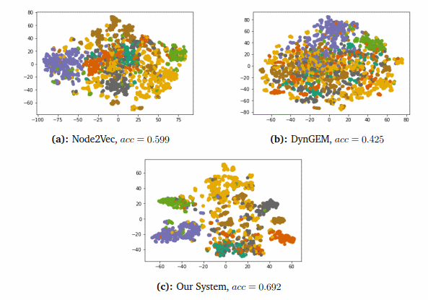
Embedding Results: CORA
Achieves very good differentiation on CORA dataset using only adjacency matrix
Accuracy measured by matching k-means clusters to true classes
Accuracy significantly outmatches other embeddings
Accuracy comparable to decision trees
Embedding visualizations of the CORA dataset, colored by true class

Slide 37
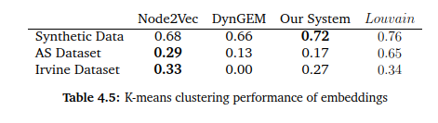
Embedding Results: Clustering
Translate k-means clusters to graph partitions, measure modularity
Strong performance, although not quite up to Node2Vec on real-world data
Approaches Louvain performance on synthetic model
Clustering performances on several models and datasets

Slide 38
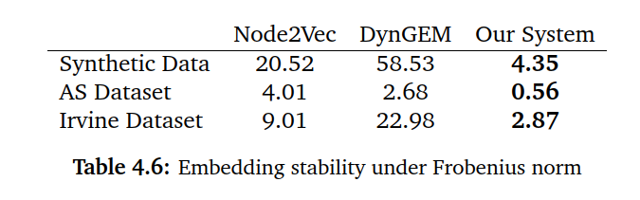
Embedding Results: Stability
Measured as Frobenius norm of difference between embeddings over difference between adjacencies
Best performing metric of our system
Consistently outperforms baselines
Stabilities of several models and datasets

Slide 39
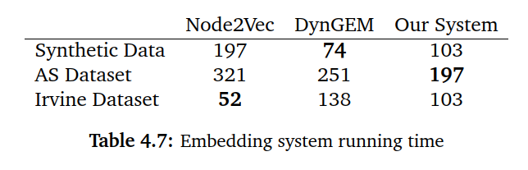
Embedding Results: Running Time
Measured as time to achieve results noted in clustering
Our model has high initial overhead but lower complexity
Slower than baselines on small datasets
Faster on larger ones
Running times on several models and datasets

Slide 40
Embedding Visualization
Used TSNE to visualize nodes over time
Initialized TSNE to old embeddings at each time step
In general networks too large for useful visual inspection
Still looks cool
Embedding visualization, colored by Apt-Markakis product

Slide 41
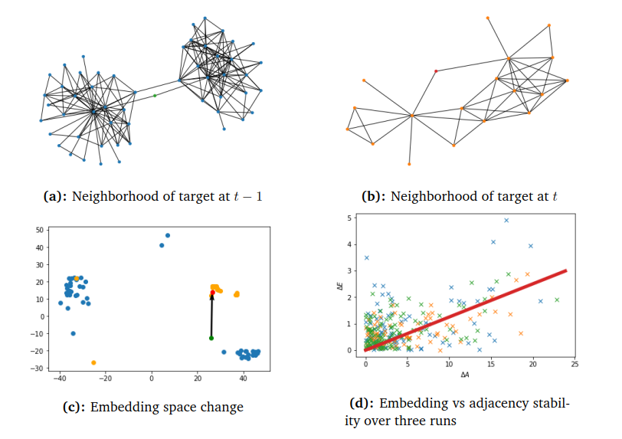
Bonus: Schelling Visualization
Examination of a node before and after Schelling step confirms accuracy of embeddings
Node begins positioned between two clusters and moves to another
Both clearly seen in embedding space
Also shown: embedding stability against adjacency stability
Schelling embedding visualization

Slide 42
Future Work Directions – Network Model
Fix the edge saturation issue
Ways to do this aren’t super clear, may need to fundamentally rethink the entire model
Improve performance, there’s some optimization that could probably be done

Slide 43
Future Work Directions – Embedding System
Try different network architectures
Multimodal variational autoencoder
RNN architectures
Study node trajectories over time
Future cluster membership prediction
Would require large annotated dataset and a lot of computational power

Slide 44
Any Questions?

